Slide 1
Epoch 404
Automatic Number Plate Recognition (ANPR) System
RA2011003010848- L SRI NIDESH,
RA2011003010877-B SAI PRANAV
RA2011003010834-KUNAL ROY CHOUDHURY

Slide 2
License Plate Recognition
Problem Statement :
To develop a system that can recognize license plate from a given image or video and identify the car number as text
Future Implementation :
To integrate code in RaspberryPi and Camera module in order to create a device that should search the database for that recognized number plate in order to create a surveillance system

Slide 3

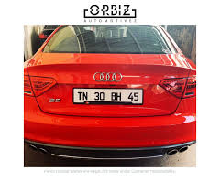
Working
Upload image or video in the web application
Perform edge detection and contour forming to get the dimensions of the license plate.

Slide 4
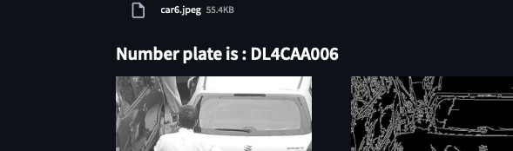
Pytesseract identifies the text in the detected license plate
Output obtained

Slide 5
Tech Stack
Libraries used :-
1)OpenCV: Helps with basic image processing
2)PyTesseract: It is an Optical Character Recognising Problem (OCR). Therefore , the Tesseract-OCR engine(pytesseract is the python implementation) helps in converting image to text.
3)Streamlit: Used to create web application for deployment and front end.

Slide 6
Applications
Parking
Access Control
Tolling
Border Control
Stolen Cars
Traffic Control

Slide 7
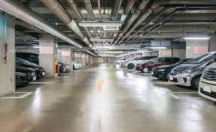
Parking
The plate number is used automatically enter pre-paid members and calculate parking fee for non-members (by comparing the exit and entry times).

Slide 8
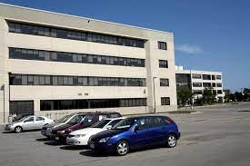
Access-Control
A gate automatically opens for authorized members in a secured area , thus replacing or assisting the security guard. The events are logged into a database and could be used to search the history of events.

Slide 9
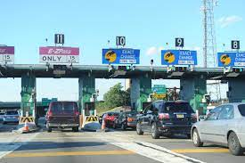
Tolling
The car number is used to calculate the travel fee in a toll road, or used to double-check the ticket.

Slide 10
Conclusion
There is an immediate need of such kind of Automatic Number Plate Recognition system in India as there are problems of traffic, stolen cars etc.
This system is very economical and eco-friendly, if applied effectively.
This will help automate various process in parking lot , traffic control and surveillance management

Slide 11


Slide 12


